Slide 1

Boston Public School Bus
On-Time Performance
Fall 2017
Emanuel Zanzerkia, Luying Cao, Yuan Yuan, Yaqi Huang, Xuechun Liu, Sijia Li

Slide 2
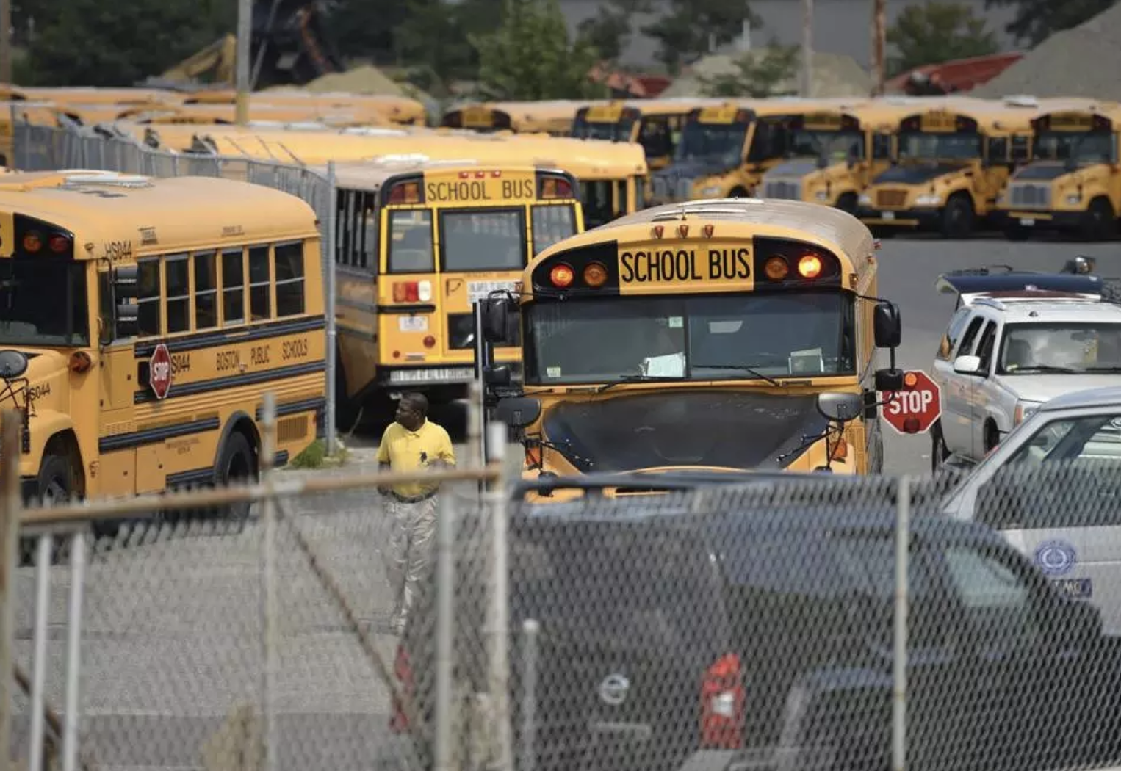
Introduction
“More than one out of 10 Boston school buses have been arriving late to school this fall … The tardy buses have been creating frustrations for parents, students, and school officials across the city” —— Boston Globe 10/30/2017
https://www.bostonglobe.com/metro/2017/10/29/many-bps-buses-still-arriving-late-school/KHarf0lhbMVrMLN2wx74FI/story.html

Slide 3

Project Overview
Objective:
Identify what factors are associated with arrival delays of Boston Public School buses looking at the data from Fall 2017 .
Data Supplied:
Structure of the data
Major variables included

Slide 4
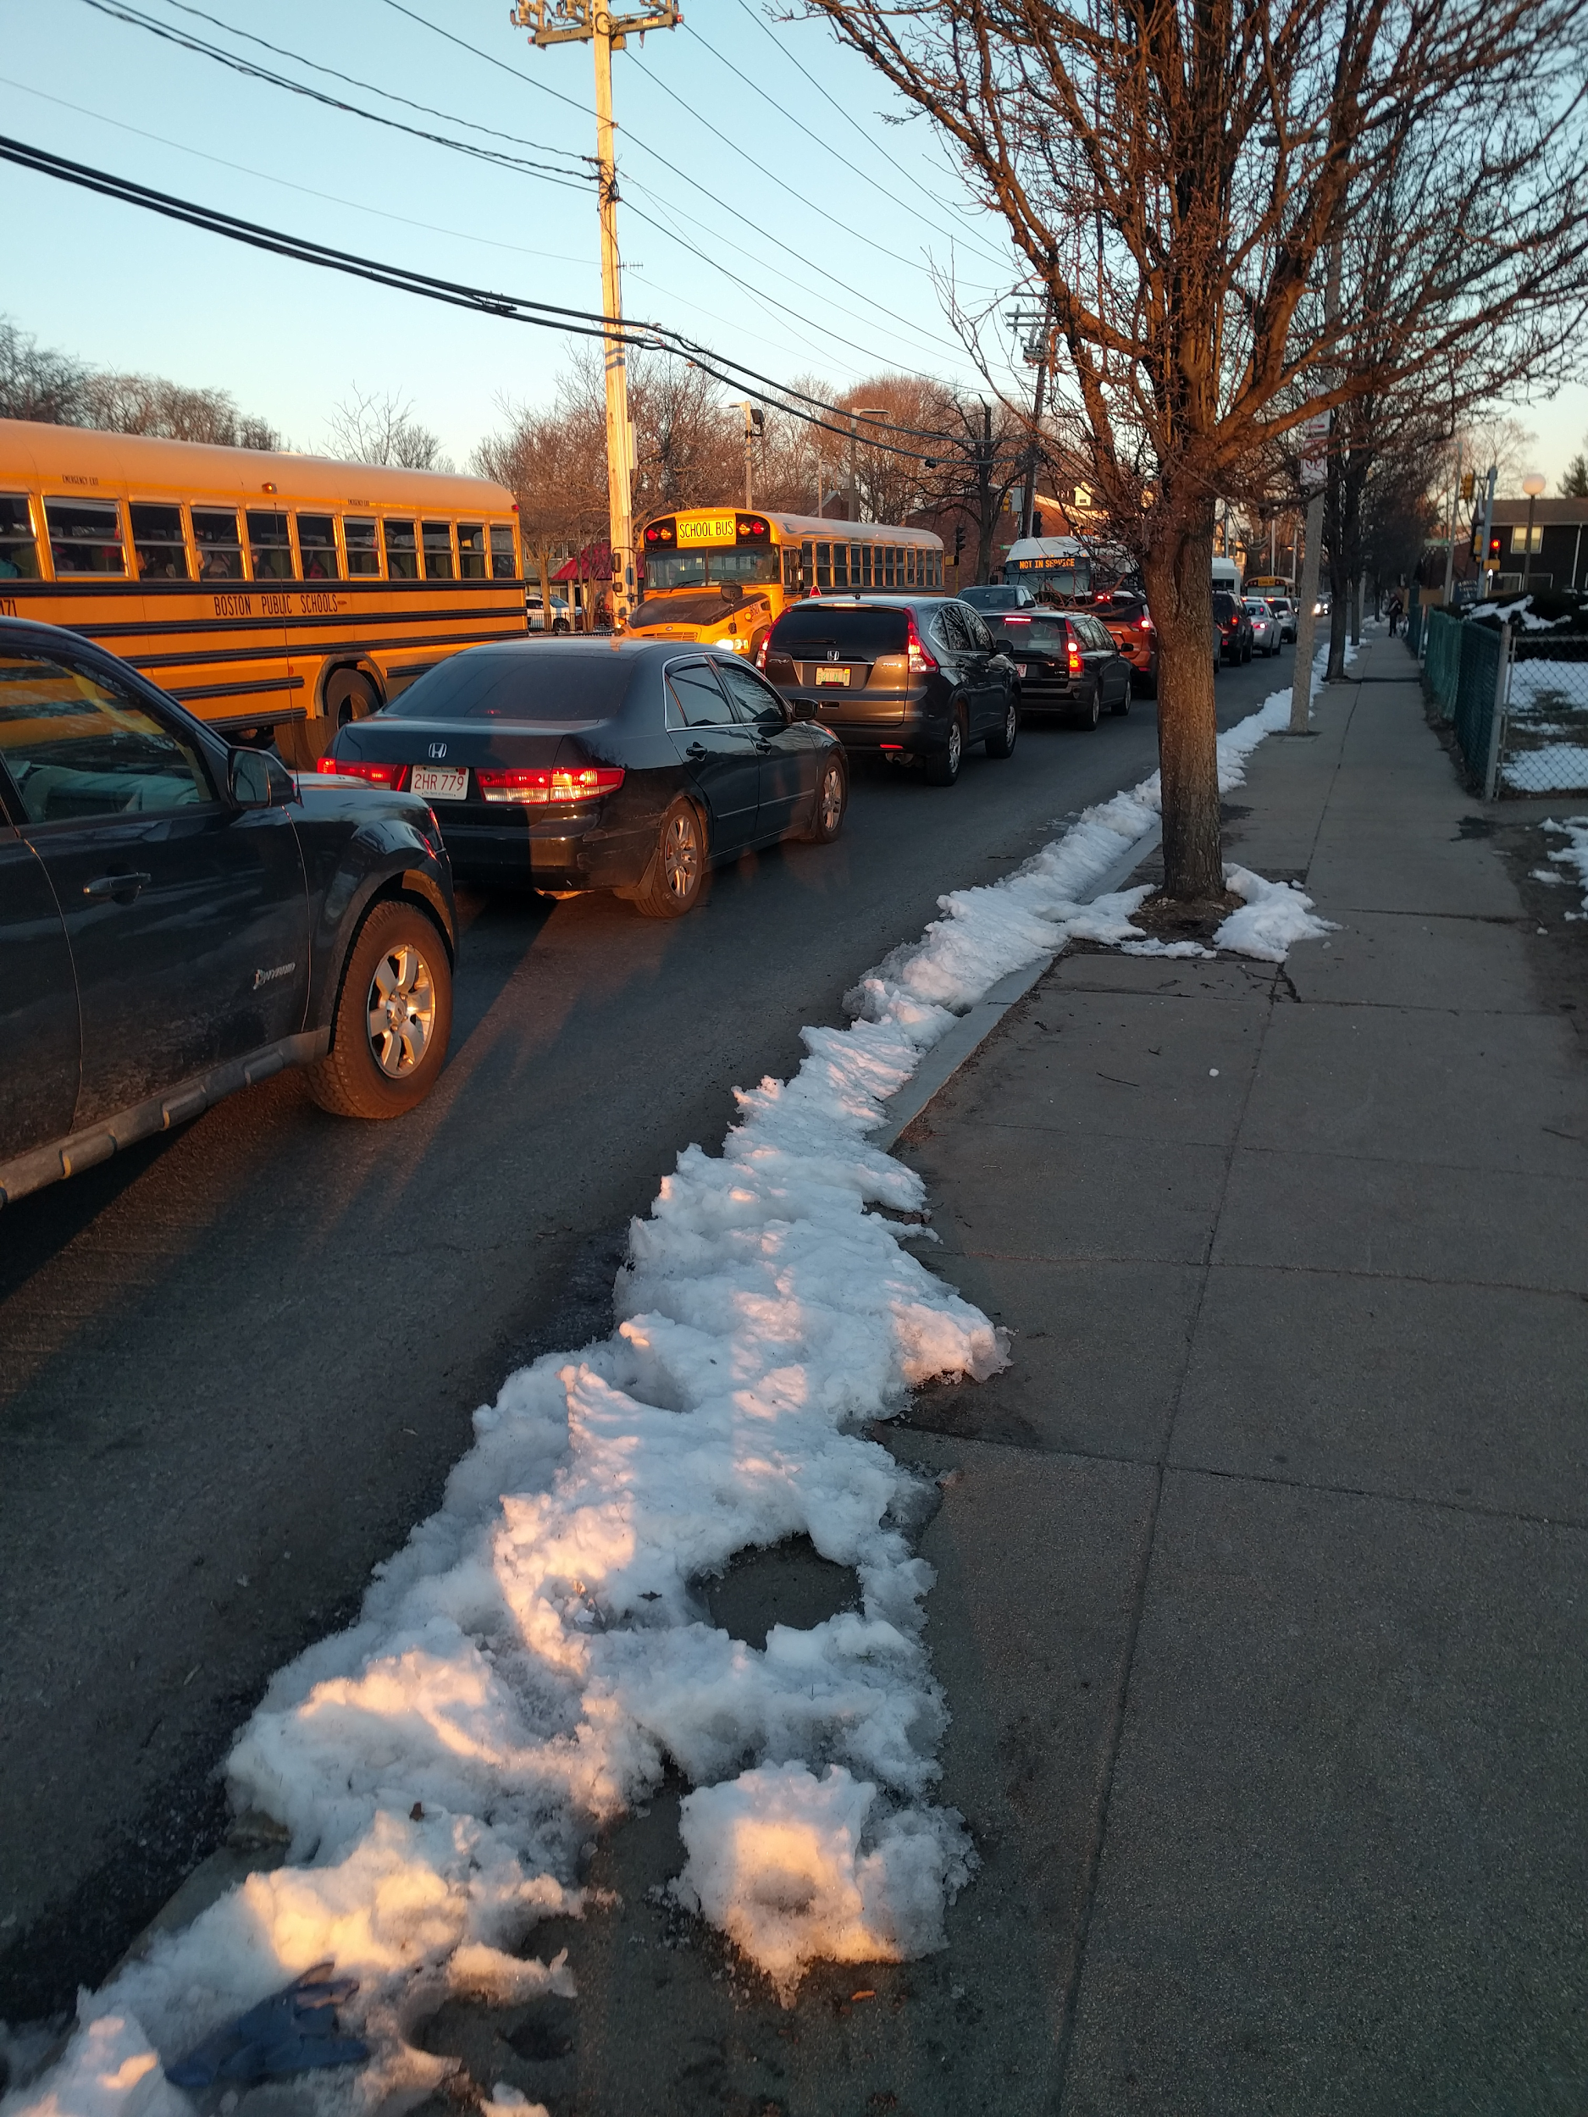
School Visits
Traffic jams for schools with insufficient drop off areas
Various reasons for buses waiting:
Other buses
Parents
Teacher supervisor
Monitors

Slide 5

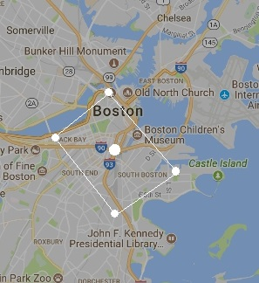


Acquisition of Further Data
Further data that was generated included:
Weather data from Weather Underground
Inbound/Outbound route classification
School type and grades serviced
Traffic Minutes
Over bridge route classification

Slide 6
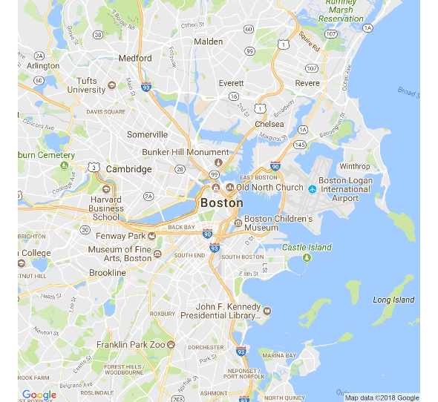
Traffic Minutes
Unable to gain access to historical traffic data
Encoding traffic
Calculate the time from the routes starting point to its endpoint.
Used Google’s distance api
Calculated trip time when route actually occurred and at 3:30am
Difference in trip times is being considered as traffic minutes.
7:00 Trip Time: 45 min
3:30 Trip Time: 30 min

Slide 7
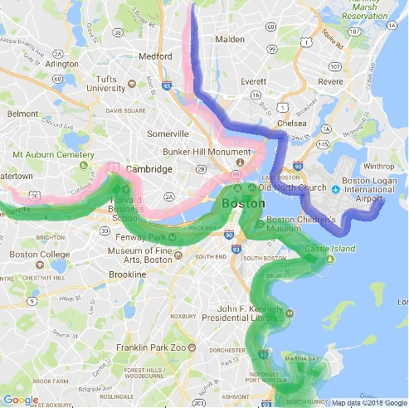
Over Bridge Route Classification
Every school was located in one of the three designated sections.
If a route starts in one section and ends in another, we consider it going over a bridge.

Slide 8
Data Exploration

Slide 9
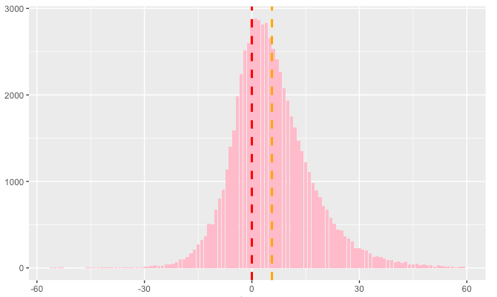
Overall Distribution of Arrival Delay
Arrival Delay > 0:
delay since the planned arrival time
Before Anchor Time
After Anchor Time
Mean = 6 mins
Count
Arrival Delay

Slide 10
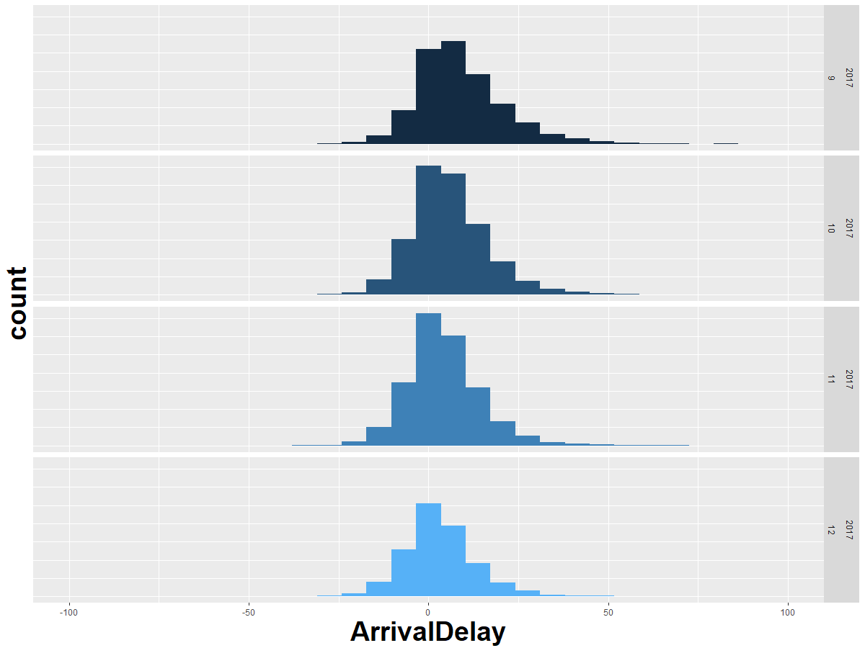
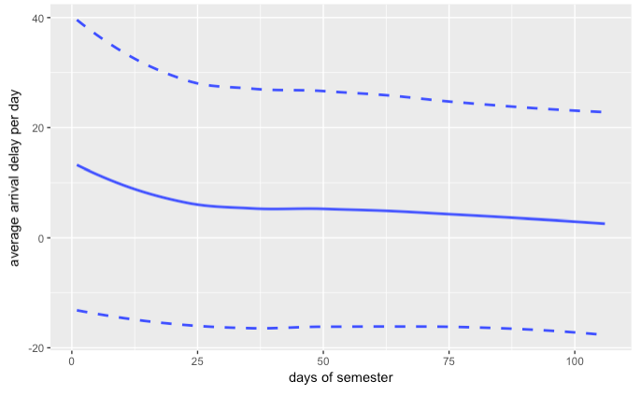
Arrival Delay Improves as Semester Progresses
Average Arrival Delay Per Day
2017.09
Arrival Delay per Day
Sep 7
2017.10
mean
Dec 21
2017.11
2017.12
days of semester
Notes:
State clearly from 13
Average all the school per day

Slide 11
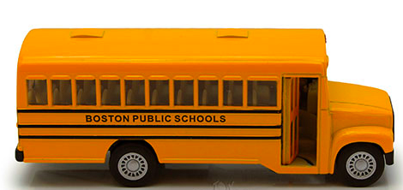
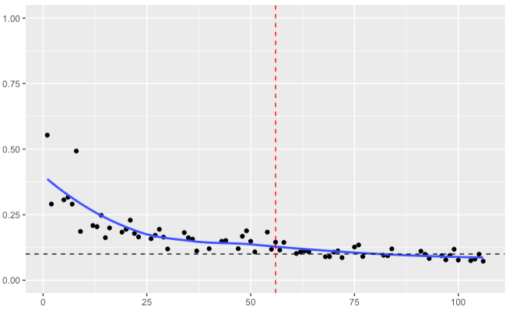
Confirmation
Nov.1st
Proportion Late Per Day
Delay Proportion per day
Delay: Bus arrived after the Time Tier (the time when schools begin)
“More than one out of 10 Boston school buses have been arriving late to school this fall … The tardy buses have been creating frustrations for parents, students, and school officials across the city”
—— Boston Globe 10/30/2017
10%
Days of semester

Slide 12
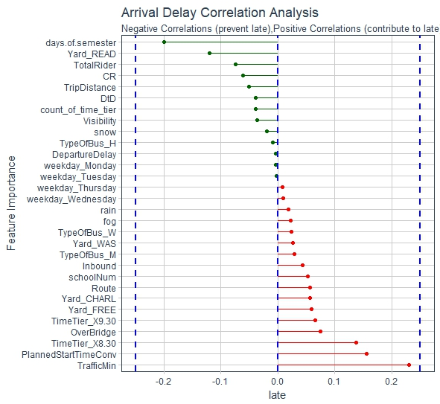
Factors that are correlated with delays
Delay Worse:
Traffic
Overbridge
Time Tier 8:30
Delay Remission:
Days of Semester
Yard Read
Total Riders
Notes:
Change color of the line

Slide 13
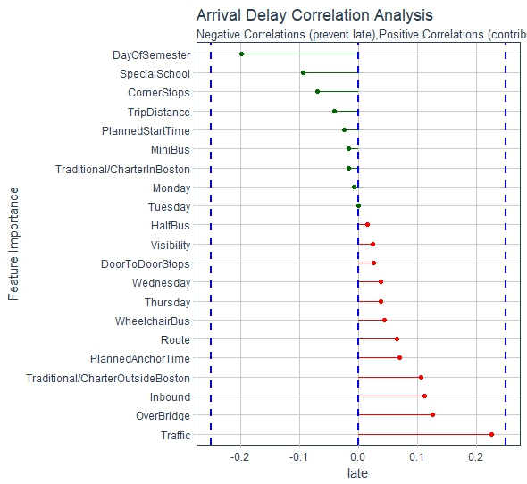
September
Days of Semester negative correlation
Traffic positive correlation
Wheelchair Bus positive correlation
Days of Semester negative correlation
Traffic positive correlation
Thursday positive correlation
7:30
Days of Semester negative correlation
Traffic positive correlation
Overbridge positive correlation
8:30
9:30

Slide 14
December
Traditional/Charter in Boston negative correlation
Traditional/Charter outside Boston positive correlation
Traffic positive correlation
7:30
Days of Semester negative correlation
Traffic positive correlation
Overbridge positive correlation
8:30
Traditional/Charter in Boston negative correlation
Traffic positive correlation
Special School positive correlation
9:30

Slide 15
Analysis

Slide 16
Factors that affect the delay at Different Time Tier
Baseline: private school
Significant
Average effect
Special School 5.65 mins
Big Bus: Door to Door Riders 2.32 mins
Snow: 1.17mins
7:30
Mini Bus : 5.55 mins
Fog : 2.55 mins
Wheelchair bus: Total Riders 1.62 mins
8:30
Snow: 1.66 mins
Baseline:
big bus
9:30

Slide 17
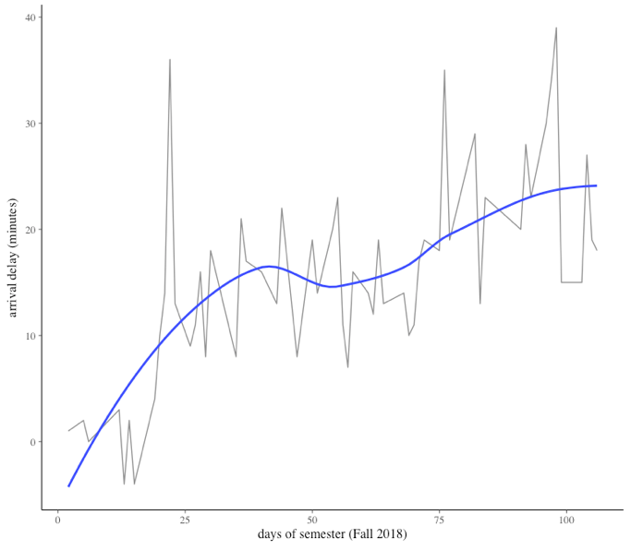
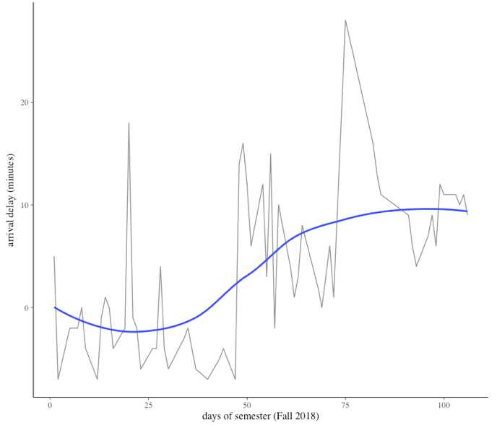
Routes that perform worse as semester progresses
Route: 52013111
School: Conservatory Lab Hancock
Route: 41712258
School: Lyon K 8
Notes:
41712258 is a minibus
52013111 is a bigbus

Slide 18
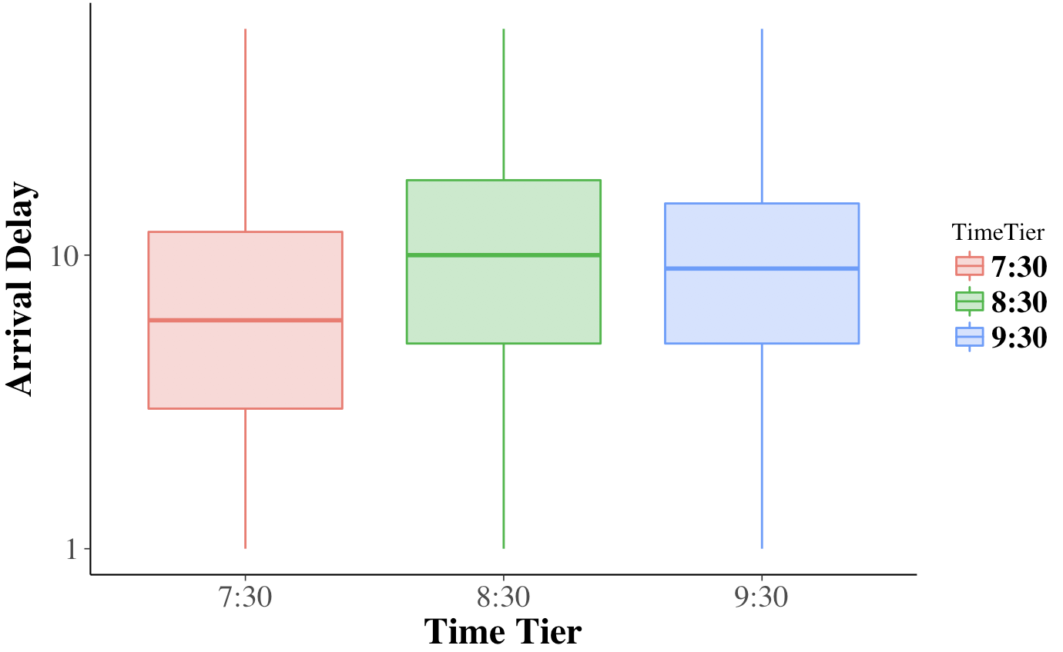
Delay Time for 3 Time Tiers
Increase
in delay
Decrease in delay
Notes:
Indicates the allocation of time for 930 probably well

Slide 19
Continued… Buses Followed this Pattern
B439
MS145
HS283

Slide 20
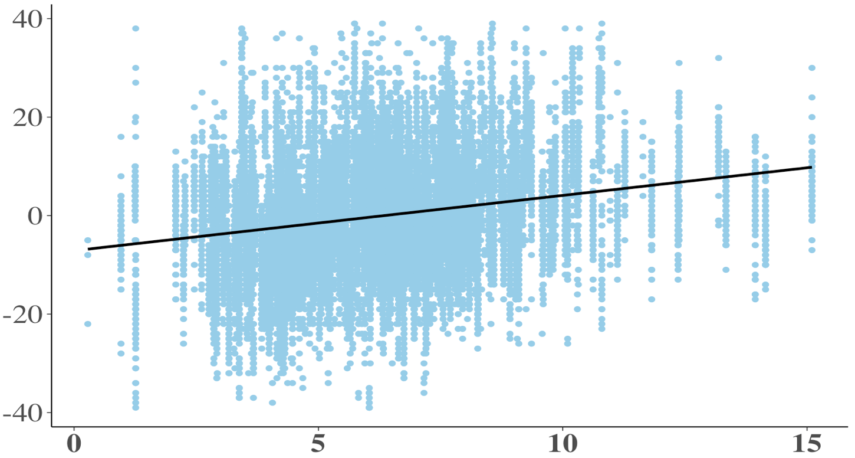
Difference in Arrival Delay from 8:30 School to 9:30 School
More delayed at 9:30
Arrival Delay Difference
Further the 9:30 school from 8:30 school travelled
Distance (miles)
Notes:
Regression, dis vs delay significant
However buses did not follow the pattern

Slide 21
Continued… Buses DID NOT Follow this Pattern
HS226
HS242
MS231

Slide 22
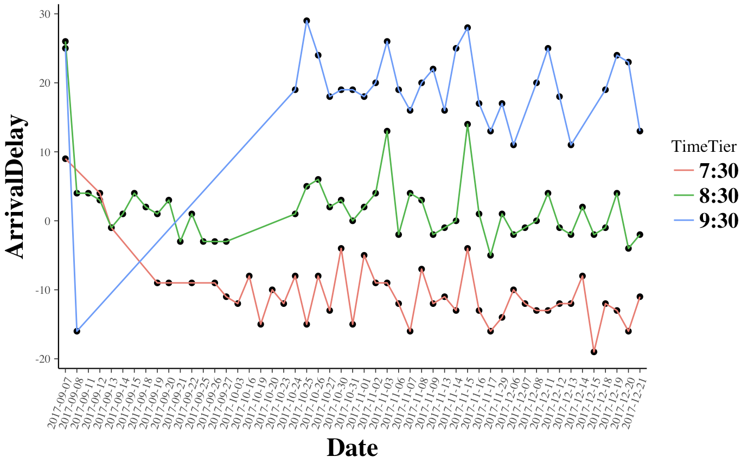
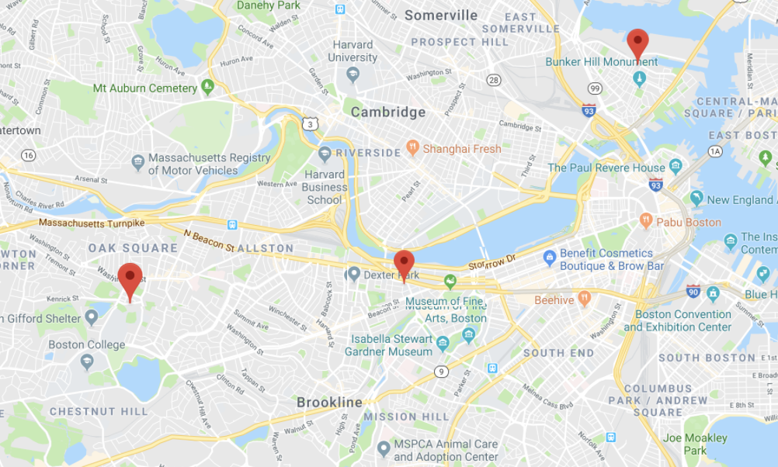
Overall Performance for BUS MS 231
9.30
Charlestown High
7.30
8.30
Edison K-8
8.30
8.12 miles
McKinley Middle
9.30
3.91 miles
7.30
Notes:
Inbound 930 late worse, delay accumulating
Edison k8 - tradi
Mckinley special school : kids take time, suggest more time allocated (inbound, kids need more time)

Slide 23
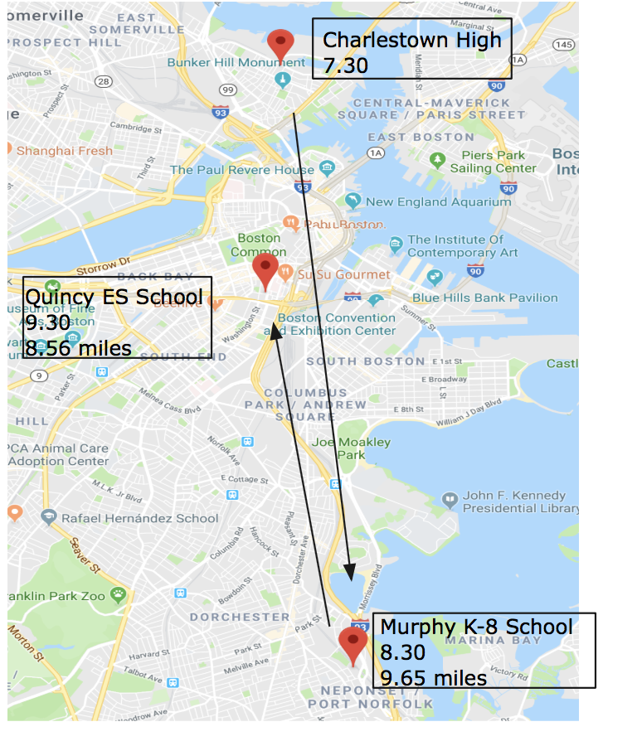
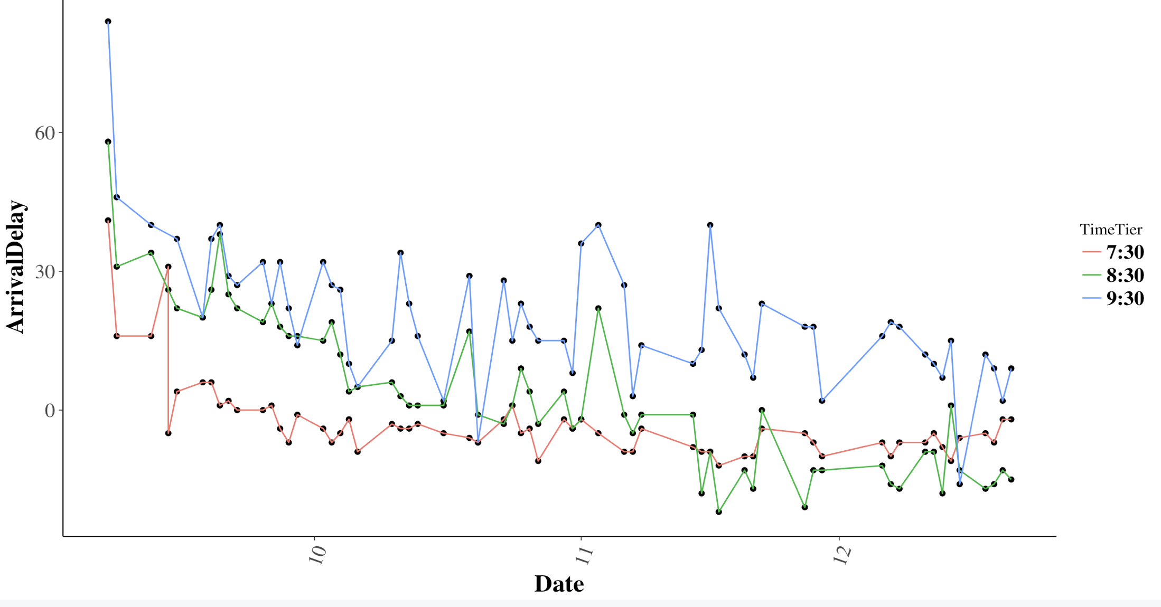
Overall Performance for BUS WB 945
9.30
8.30
7.30
Notes:
Quincy es - traditional

Slide 24
Predictive Modeling

Slide 25





Models Introduction
Tree-based models are able to rank factors by their explanation power for model’s response variable (Arrival Delay).
Predictive Accuracy
Notes:
Ranking factors
Prediction accuracy

Slide 26
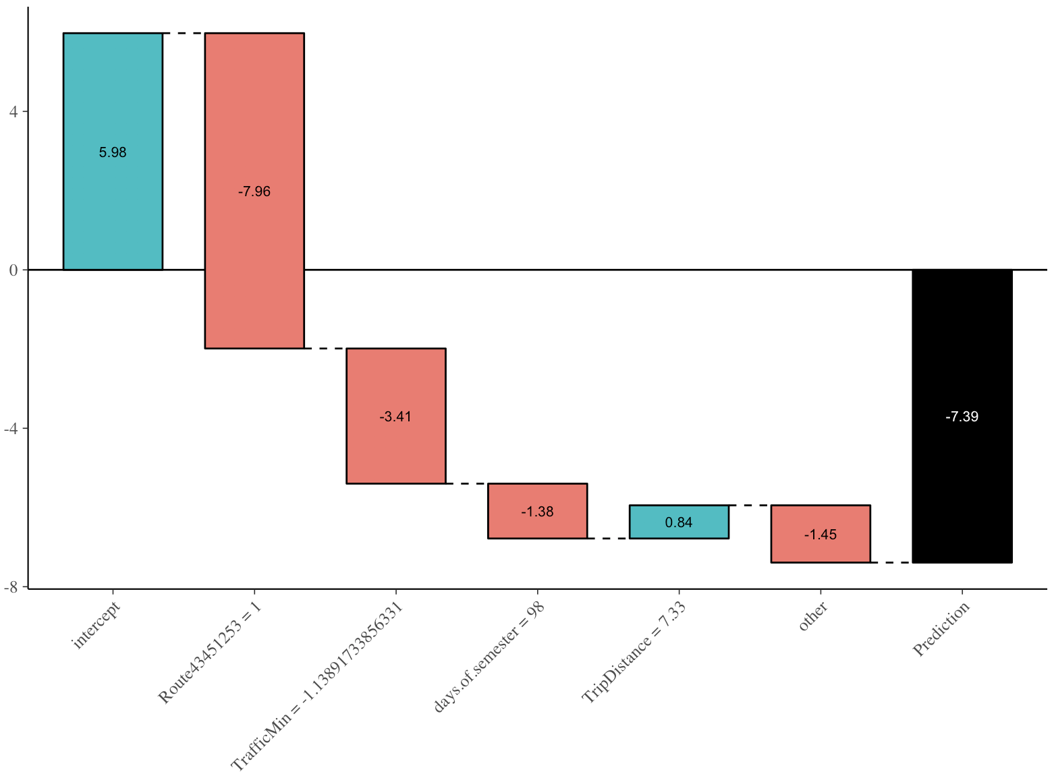
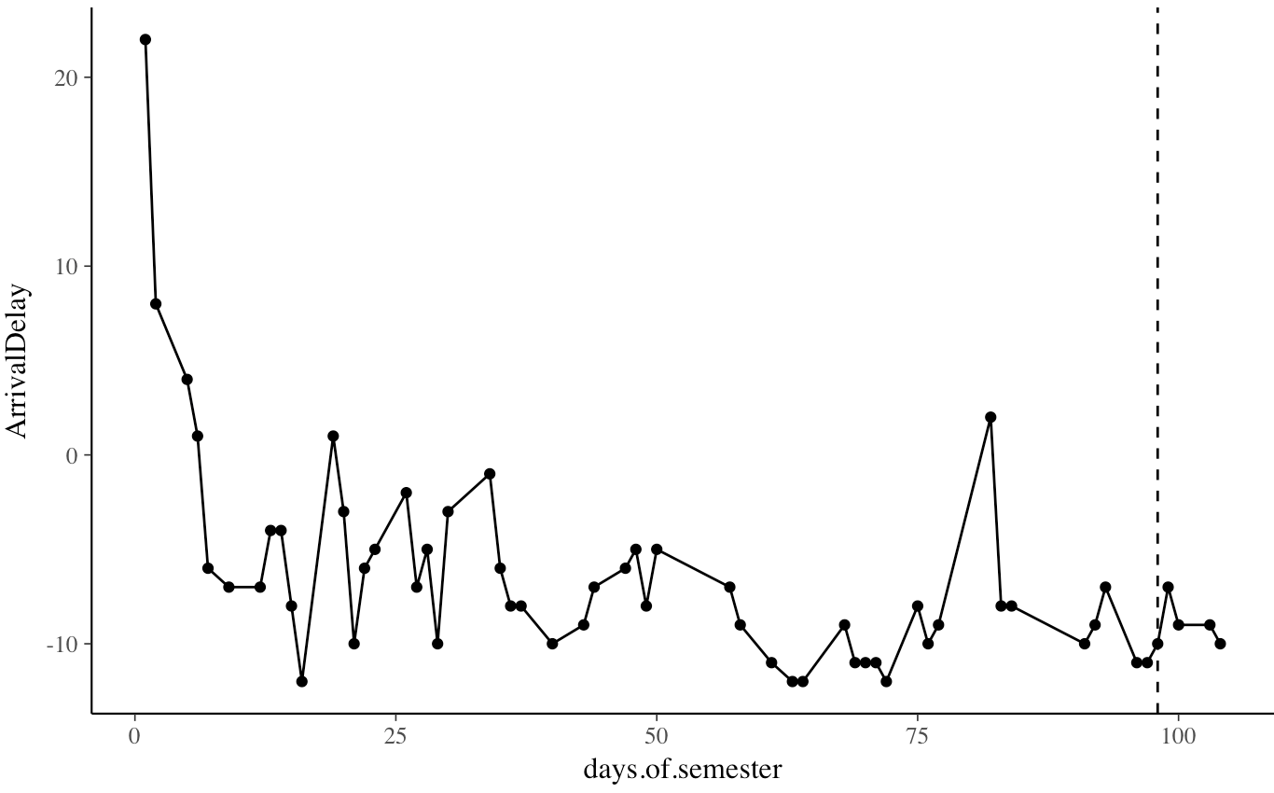
XGBoost Model Illustration
The model has 90% confidence of predicting arrival delays 10 mins within its true value
Route 43451253
Day 98
Average Delay
Predicted Performance: Arriving 7 mins early
Actual Performance: Arriving 10 mins early
Traffic = -1.14
Notes:
Decompose the arrival delay

Slide 27
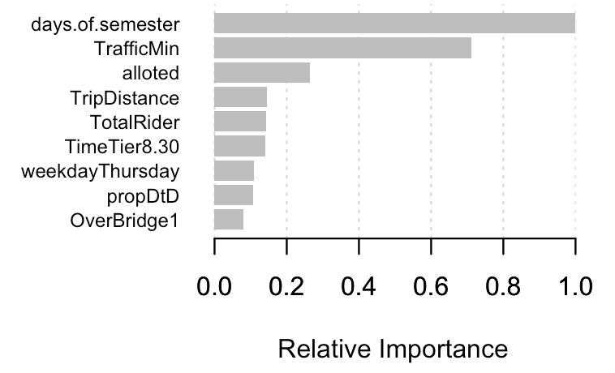
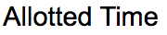
Models
XG Boosting Variable Importance

Slide 28
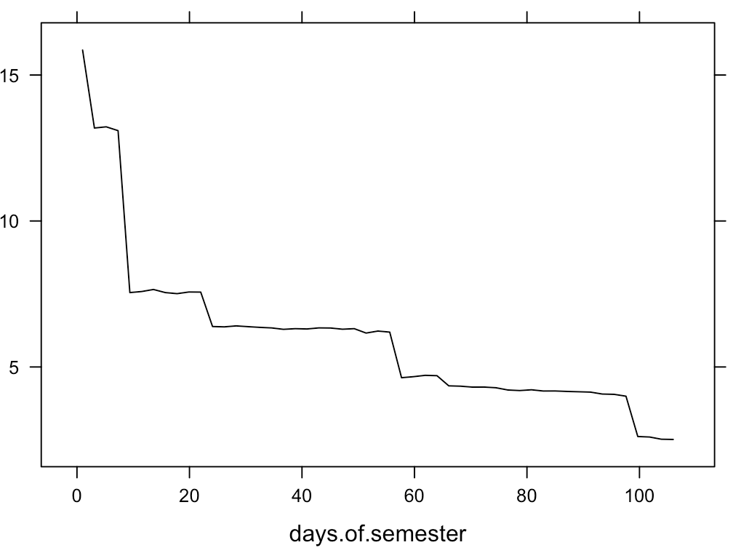
Models
As semester goes on, drivers get better at arriving on time
XG Boosting Variable Importance
Arrival Delay

Slide 29
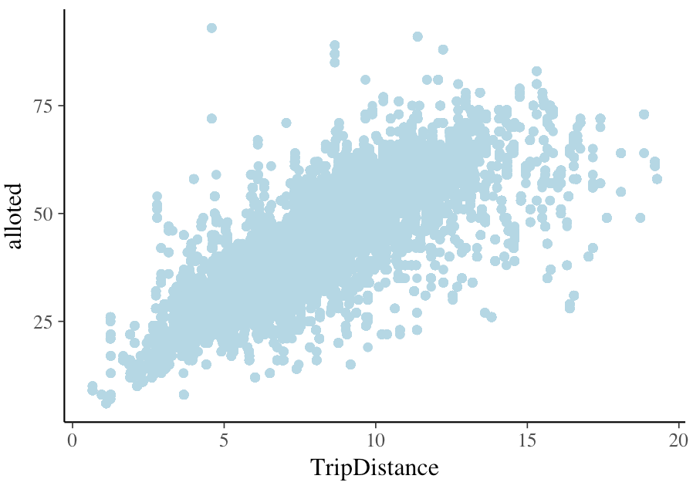
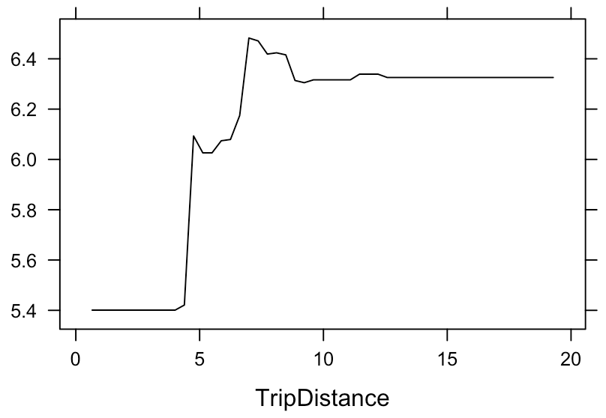
Models
Allotted TIme
Trip distance and allotted trip time are highly correlated, longer trips have longer allotted time
There are concentration of delayed arrival for trips that are less than 10 miles
Arrival Delay
Notes:
Tripdis <20 newdata

Slide 30
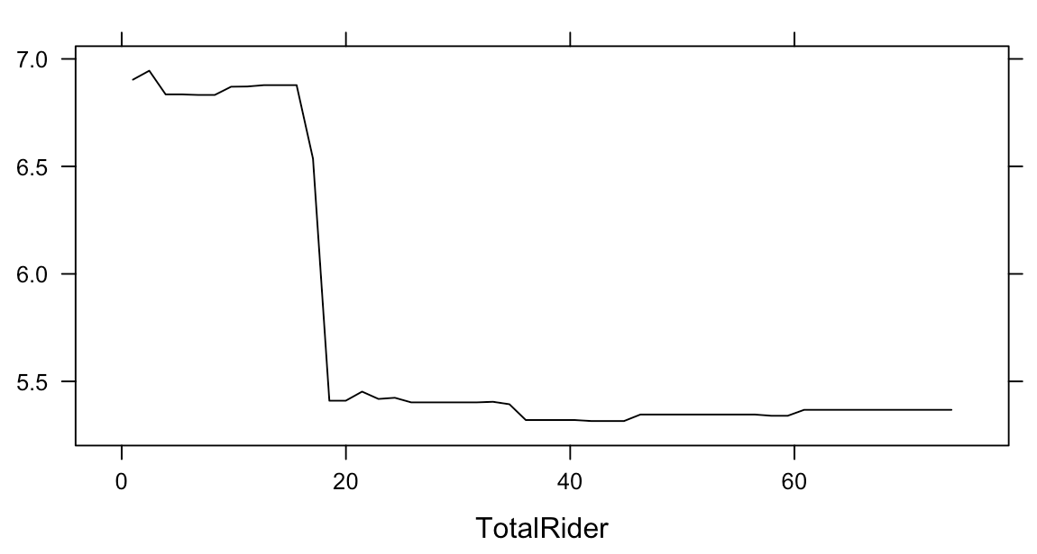
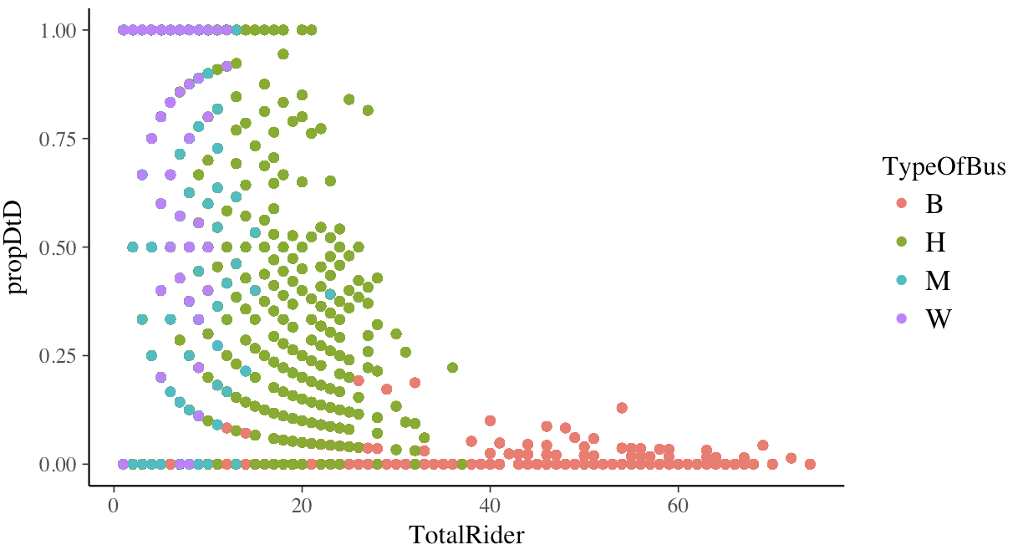
Models
Arrival Delay
Buses with higher proportion of door to door riders are more likely to delay
Average time for picking up a door to door rider is longer than picking up a corner stop rider

Slide 31
Discussion
Arrival delays are associated with multiple factors:
Weather
Traffic
Proportion of Door-to-Door Riders
Our analysis looked into the combined effect of factors and each of their contribution to on-time performance.
Ranking the contribution of factors give us directions for further analysis: traffic budgeting, allotted time optimization …...

Slide 32
Acknowledgement
Boston Public Schools
Will Eger
John Roderick
Boston University MS in Statistical Practice

